Slide 1
Caretaker's Cycle
Developers:
Haider Salim
Asad Ali

Slide 2
Introduction
In an Earth where nature and machines have learned to live without humans, an alien caretaker wants to find human legacy and preserve this balance. As the player, you explore abandoned places, identify areas where the natural-tech symbiosis is faltering, and solve environmental puzzles to restore equilibrium. Through calm exploration and gentle intervention, you uncover remnants of a long-lost human civilization, piecing together the story of Earth’s transformation.

Slide 3
Gameplay Loop
Alien arrives in a biome.
Explore the area.
Identify issues where harmony is broken (e.g., stuck machine, overgrown tech).
Solve environmental puzzles to fix the issue.

Slide 4
Core Mechanics
Movement: Run, Jump and sprint
Puzzle Types: Light logic, environment manipulation, energy routing.
Interaction: Use Gravity Gun.
Progression: Fix the malfunctioned tech

Slide 5
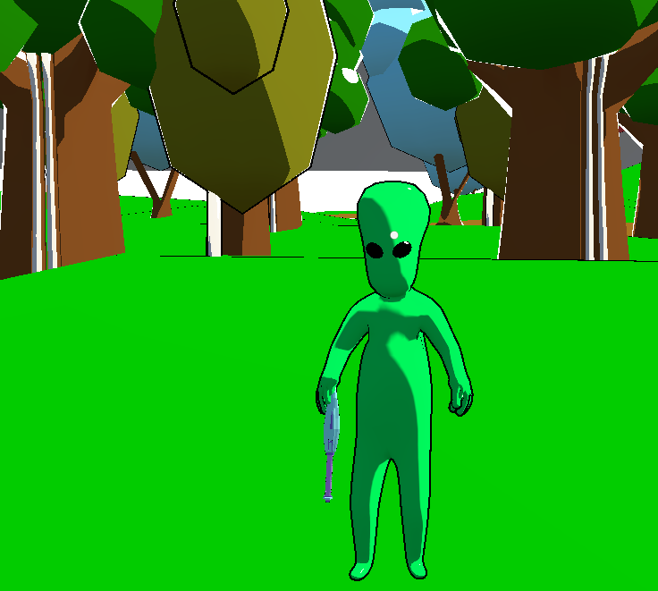
Tone & Visual Style
Visuals: Stylized nature + Toon
UI: Minimalist

Slide 6
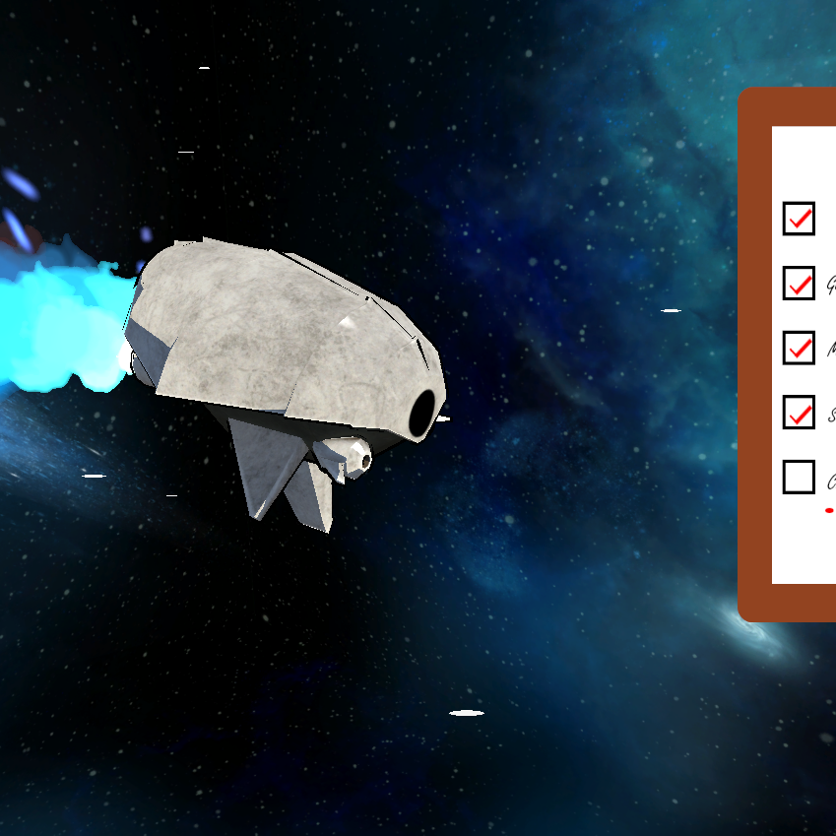
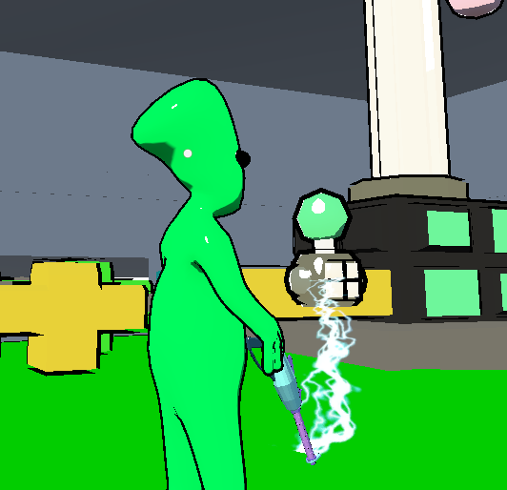
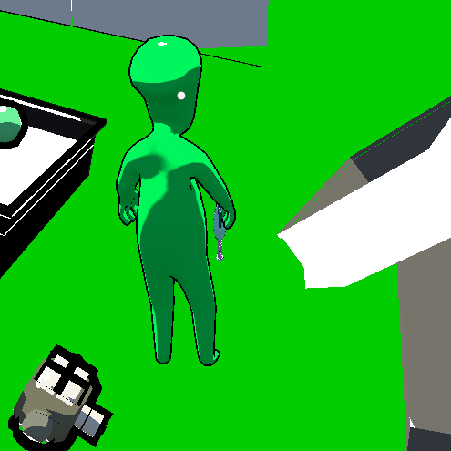
Add Pictures
Picture #1
Picture #2
Picture #3

Slide 7
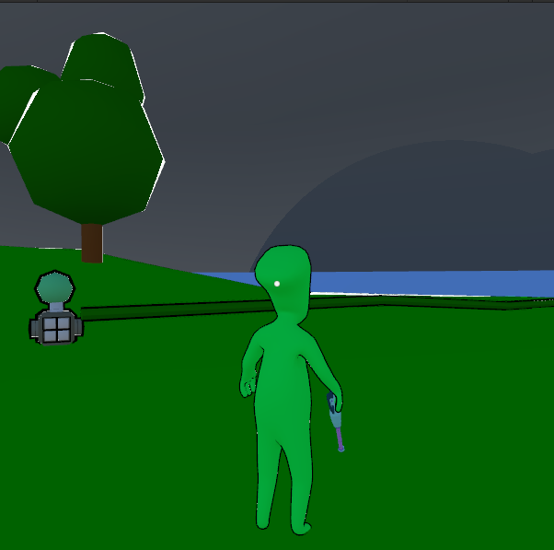
Puzzle One
Reconnect broken circuits by wiring bulbs and a generator.
Explore the area and see what is required to restart the process .i.e which type of trees.
One or multiple

Slide 8
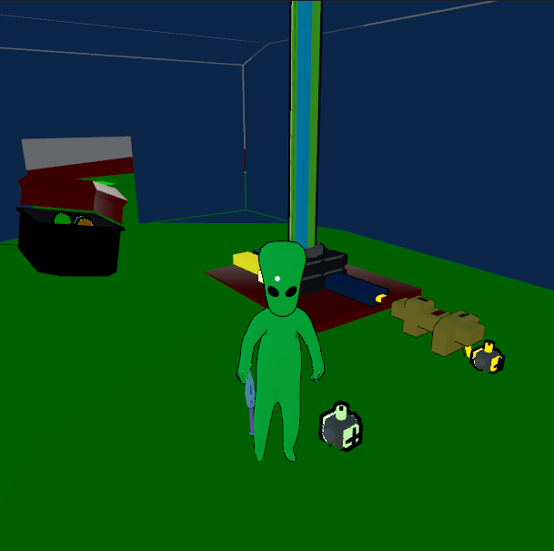
Puzzle Two
Restore environmental balance by planting two trees in designated zones.
Small environmental clues and objects hint at humanity's past.
Player must actively balance nature and tech elements to progress.

Slide 9
Thank you

